Slide 1
2/6/19 Meeting Update
MacroFab = PROBLEMS

Slide 2
Agenda
Progress
Next steps
Miscellaneous

Slide 3
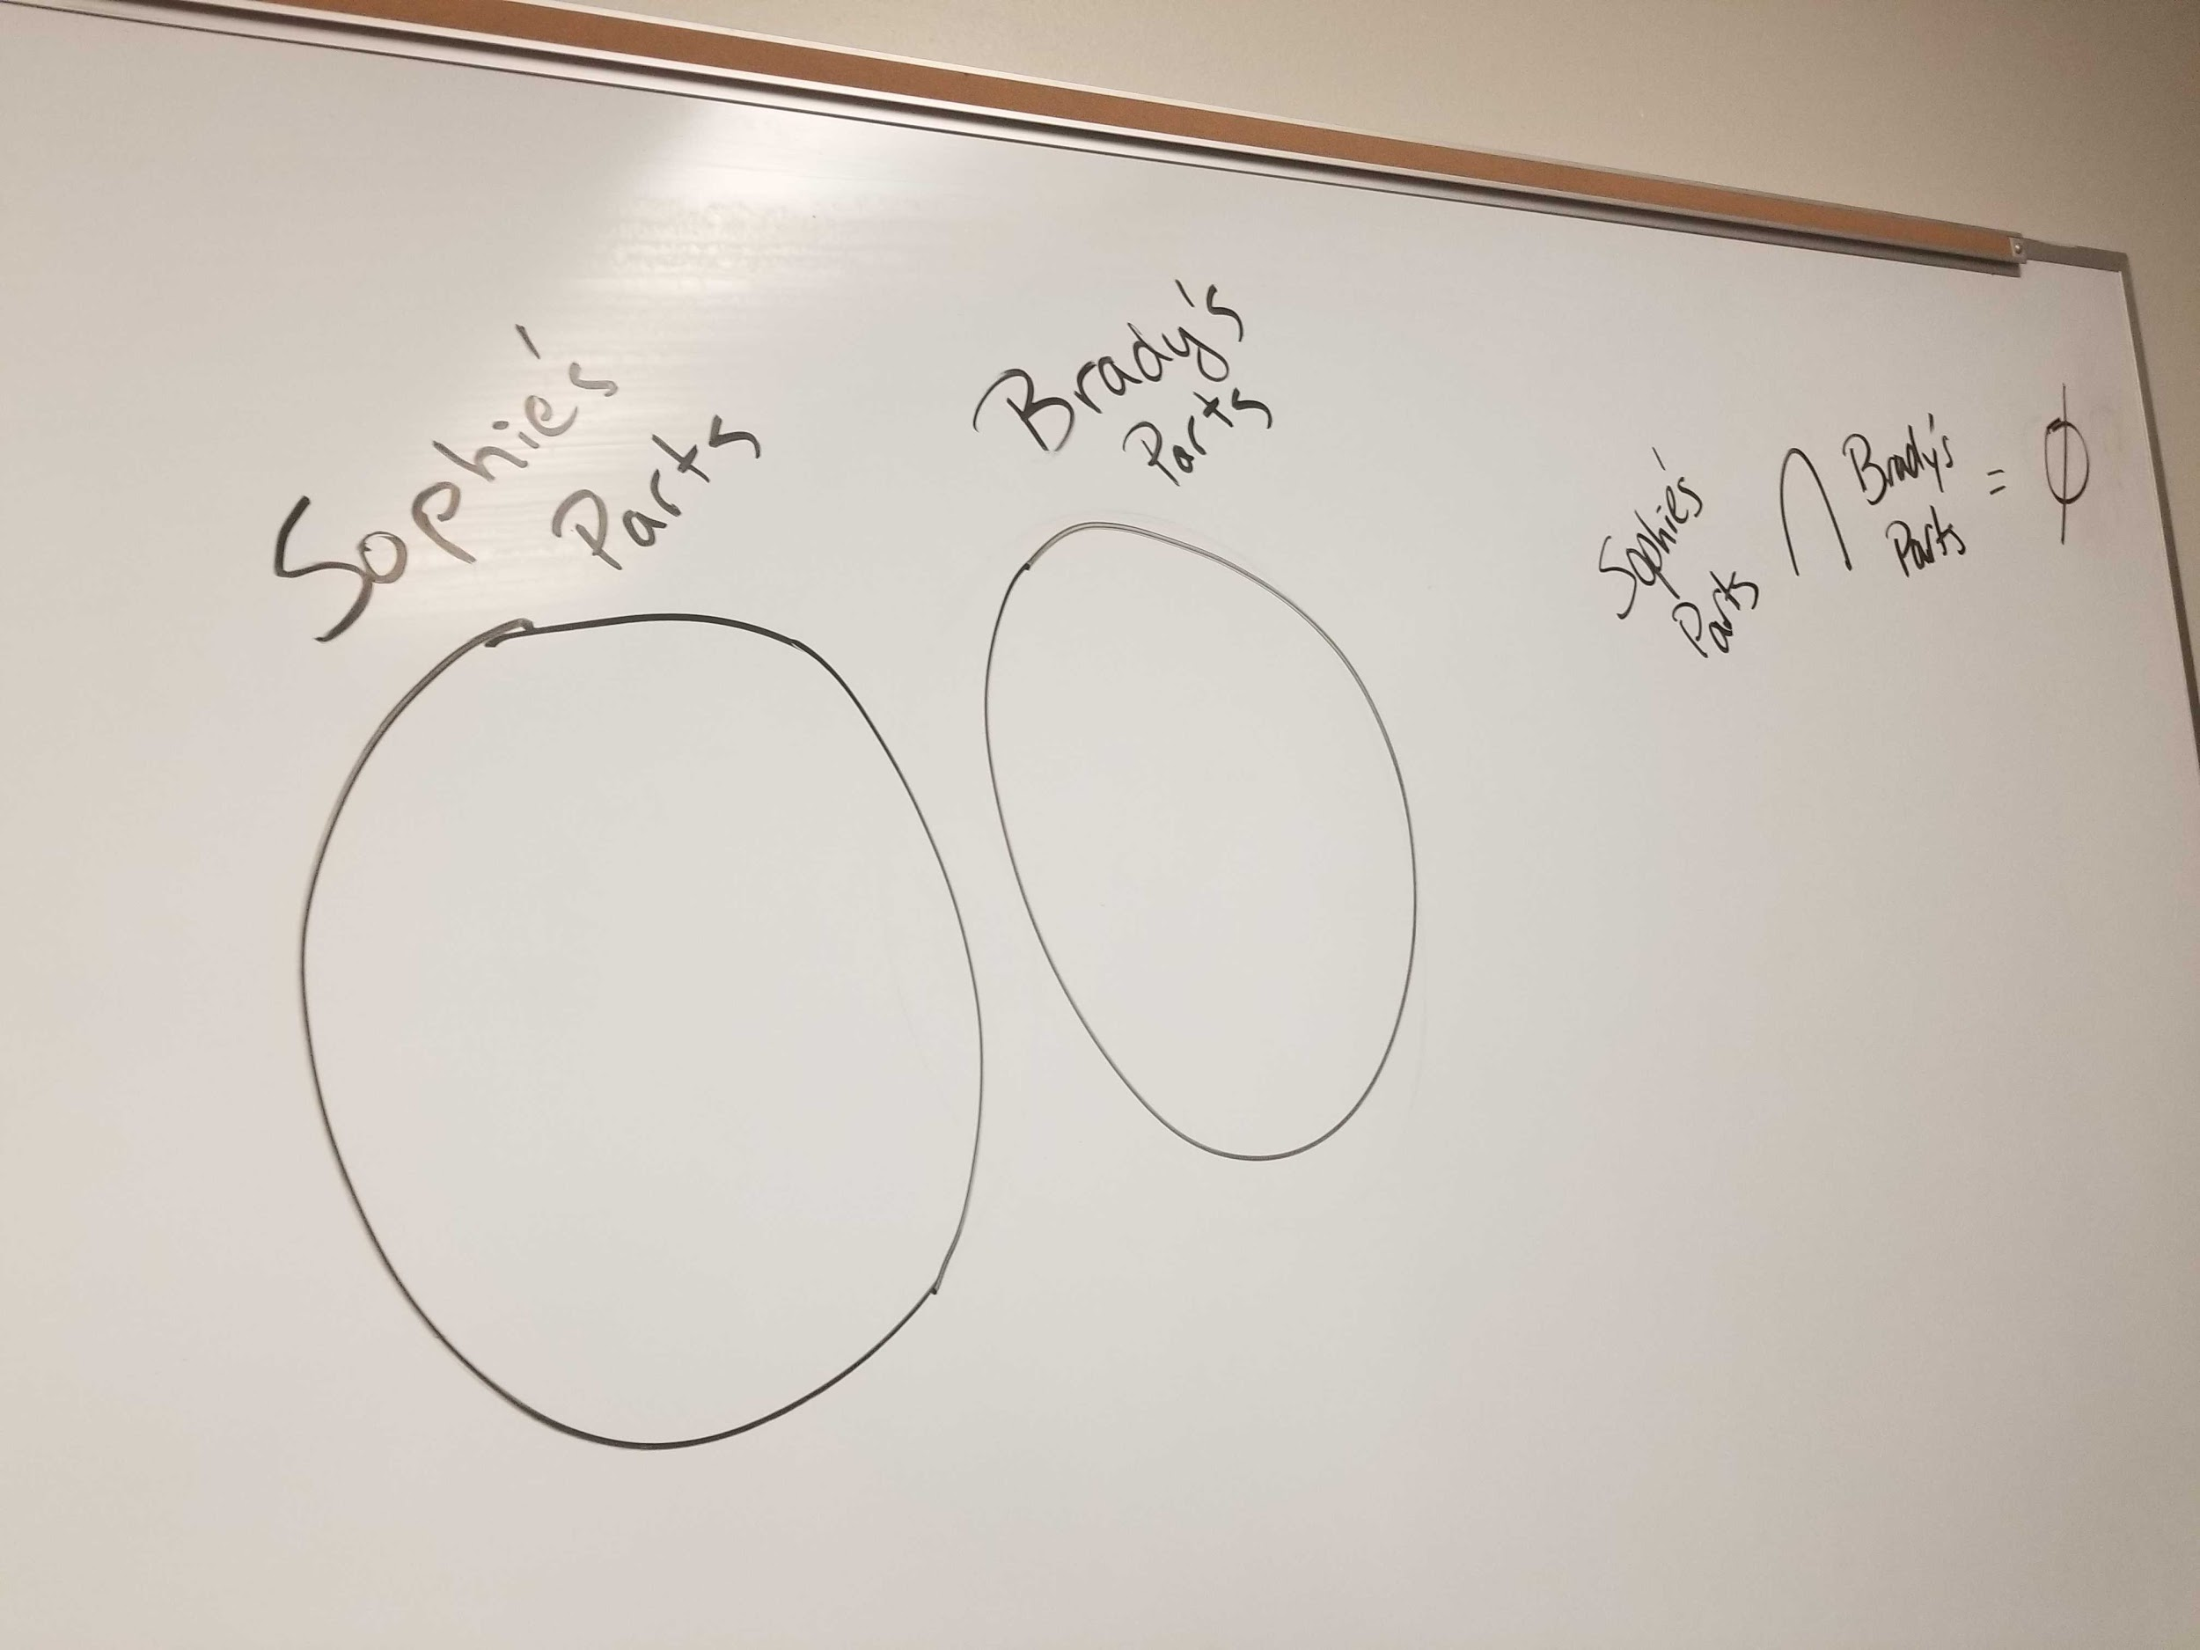
Progress

Slide 4
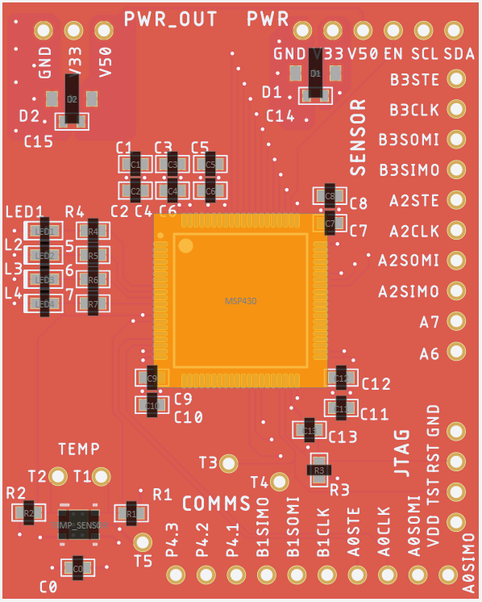
Prototype #2 PCB Design - Complete
Processor & Comms boards
Final design review with Erik - Wed night
Final changes/updates - Thurs & Fri
Dropped off parts at Macrofab - Fri (big mix-up here)
Ordered yesterday
Potential problem: showing rotated part placement
Emailed Erik for advice
Estimated delivery: Feb. 19
Power board
Attempted to order yesterday
BGA component (fuel gauge) does not fulfill DRC rules
Emailed Erik for help
Looks like we will have to choose a different component

Slide 5
Comms Code
Progress on this code has stalled due to work on PCB design. Now that the PCBs have been ordered (sort of), I can focus on this a lot more.
Working on sifting through the TI example code to get what we want
Also working on how best to receive the data (e.g. phone UART app?)

Slide 6
UART Code
Got barebones “closed loop” working (no dust sensor, simply connect Tx and Rx pins on MSP and read Rx Buffer)
Demo with dust sensor not working
Not seeing Tx line on sensor getting pulled low
Possible issues: baud rate (2400) mismatch?

Slide 7
Action Items

Slide 8
Action Items
Priority: Fix power board BGA issue - Brady, Rachel
Priority: Rollout second comms board (different antenna) - Robby
Working on comms code - Nathaniel
Working on particulate/UART code - Robyn, Rachel
Working on fuel gauge code - Brady
Scheduling and prepping for meeting next week with sponsors to decide future design directions - Jennifer

Slide 9
Miscellaneous
Competition not available for submission until March
Gantt Chart

